Slide 1
On the Number of Samples Needed to Learn the Correct Structure of a Bayesian Network
Or Zuk, Shiri Margel and Eytan Domany
Dept. of Physics of Complex Systems
Weizmann Inst. of Science
UAI 2006, July, Boston

Slide 2
Overview
Introduction
Problem Definition
Learning the correct distribution
Learning the correct structure
Simulation results
Future Directions

Slide 3
Introduction
Graphical models are useful tools for representing
joint probability distribution, with many (in) dependencies constrains.
Two main kinds of models:
Undirected (Markov Networks, Markov Random Fields etc.)
Directed (Bayesian Networks)
Often, no reliable description of the model exists. The need to learn the model from observational data arises.

Slide 4
Introduction
Structure learning was used in computational biology [Friedman et al. JCB 00], finance ...
Learned edges are often interpreted as causal/direct physical relations between variables.
How reliable are the learned links? Do they reflect the true links?
It is important to understand the number of samples needed for successful learning.

Slide 5

Introduction
Let X₁,..,X_{n} be binary random variables.
A Bayesian Network is a pair B ≡ <G, θ>.
G – Directed Acyclic Graph (DAG). G = <V,E>. V = {X₁,..,X_{n}} the vertex set. Pa_{G}(i) is the set of vertices X_{j} s.t. (X_{j},X_{i}) in E.
θ - Parameterization. Represent conditional probabilities:
Together, they define a unique
joint probability distribution P_{B}
over the n random variables.
X₁
 | X₂
X₁ | 0 | 1
0 | 0.95 | 0.05
1 | 0.2 | 0.8
X₂
X₃
X₅ ⊥ {X₁,X₄} | {X₂,X₃}
X₄
X₅

Slide 6
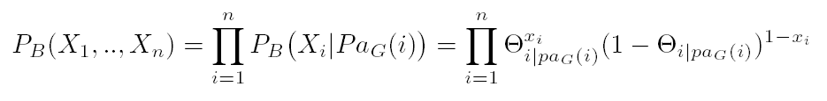
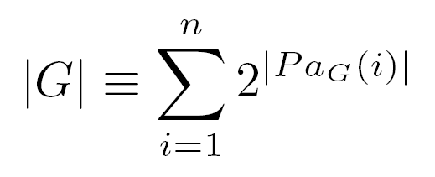

Introduction
Factorization:
The dimension of the model is simply the number of parameters needed to specify it:
A Bayesian Network model can be viewed as a mapping,
from the parameter space Θ = [0,1]^{|G|} to the 2^{n} simplex S₂^{n}

Slide 7
Introduction
Previous work on sample complexity:
[Friedman&Yakhini 96] Unknown structure, no hidden variables.
[Dasgupta 97] Known structure, Hidden variables.
[Hoeffgen, 93] Unknown structure, no hidden variables.
[Abbeel et al. 05] Factor graphs, …
[Greiner et al. 97] classification error.
Concentrated on approximating the generative distribution.
Typical results: N > N₀(ε,δ) D(P_{true}, P_{learned}) < ε, with
prob. > 1- δ.
D – some distance between distributions. Usually relative entropy.
We are interested in learning the correct structure.
Intuition and practice → A difficult problem (both computationally
and statistically.)
Empirical study: [Dai et al. IJCAI 97]

Slide 8
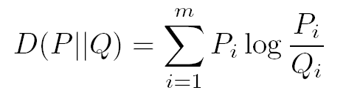
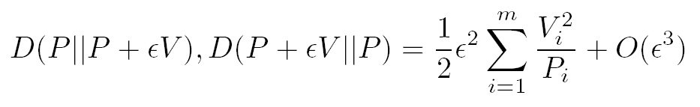
Introduction
Relative Entropy:
Definition:
Not a norm: Not symmetric, no triangle inequality.
Nonnegative, positive unless P=Q. ‘Locally symmetric’ :
Perturb P by adding a unit vector εV for some ε>0 and V unit vector. Then:

Slide 9
Structure Learning
We looked at a score based approach:
For each graph G, one gives a score based on the data
S(G) ≡ S_{N}(G; D)
Score is composed of two components:
1. Data fitting (log-likelihood) LL_{N}(G;D) = max LL_{N}(G,Ө;D)
2. Model complexity Ψ(N) |G|
|G| = … Number of parameters in (G,Ө).
S_{N}(G) = LL_{N}(G;D) - Ψ(N) |G|
This is known as the MDL (Minimum Description Length) score. Assumption : 1 << Ψ(N) << N. Score is consistent.
Of special interest: Ψ(N) = ½log N. In this case, the score is called BIC (Bayesian Information Criteria) and is asymptotically equivalent to the Bayesian score.

Slide 10
Structure Learning
Main observation: Directed graphical models (with no hidden variables) are curved exponential families [Geiger et al. 01].
One can use earlier results from the statistics literature for learning models which are exponential families.
[Haughton 88] – The MDL score is consistent.
[Haughton 89] – Gives bounds on the error probabilities.

Slide 11
Structure Learning
Assume data is generated from B* = <G*,Ө*>,
with P_{B*} generative distribution.
Assume further that G* is minimal with respect to P_{B*} : |G*| = min {|G| , P_{B*} subset of M(G))
[Haughton 88] – The MDL score is consistent.
[Haughton 89] – Gives bounds on the error probabilities:
P^{(N)}(under-fitting) ~ O(e^{-αN})
P^{(N)}(over-fitting) ~ O(N^{-β})
Previously: Bounds only on β. Not on α, nor on the multiplicative constants.

Slide 12
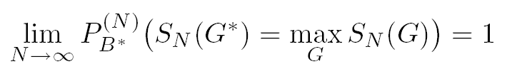
Structure Learning
Assume data is generated from B* = <G*,Ө*>,
with P_{B*} generative distribution, G* minimal.
From consistency, we have:
But what is the rate of convergence? how many samples we need in order to make this probability close to 1?
An error occurs when any ‘wrong’ graph G is preferred over G*. Many possible G’s. Complicated relations between them.

Slide 13
Structure Learning
Simulations: 4-Nodes Networks.
Totally 543 DAGs, divided into 185 equivalence classes.
Draw at random a DAG G*.
Draw all parameters θ uniformly from [0,1].
Generate 5,000 samples from P_{<G*,θ>}
Gives scores S_{N}(G) to all G’s and look at S_{N}(G*)

Slide 14
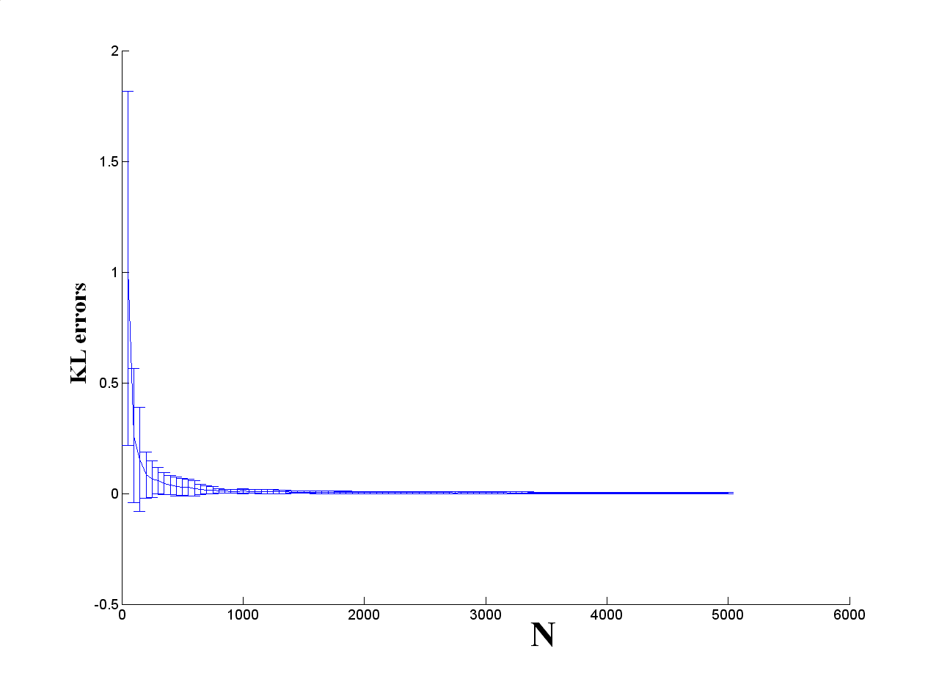
Structure Learning
Relative entropy between the true and learned distributions:

Slide 15
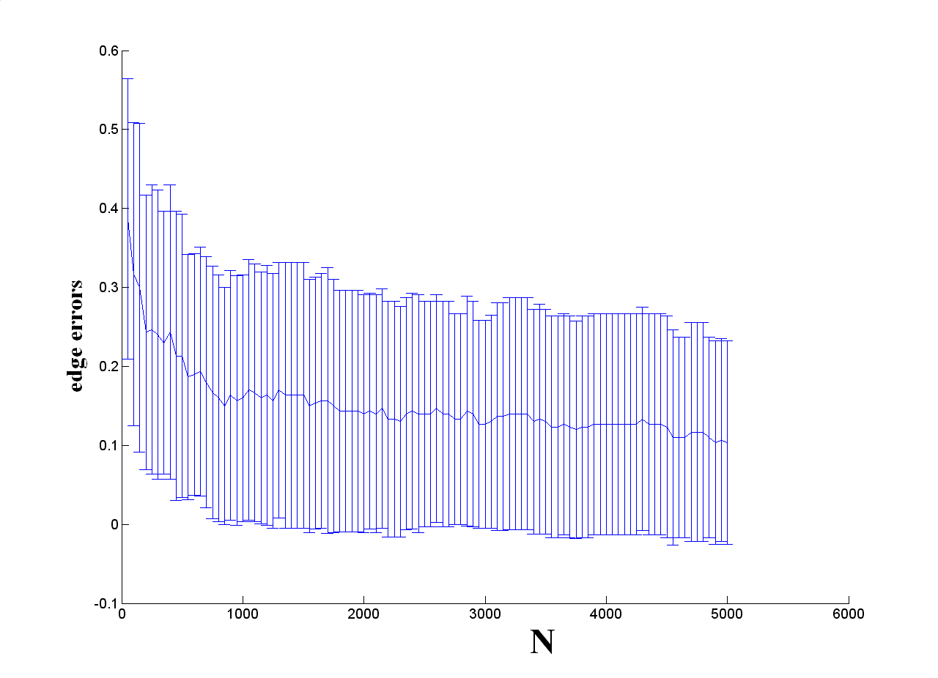
Structure Learning
Simulations for many BNs:

Slide 16
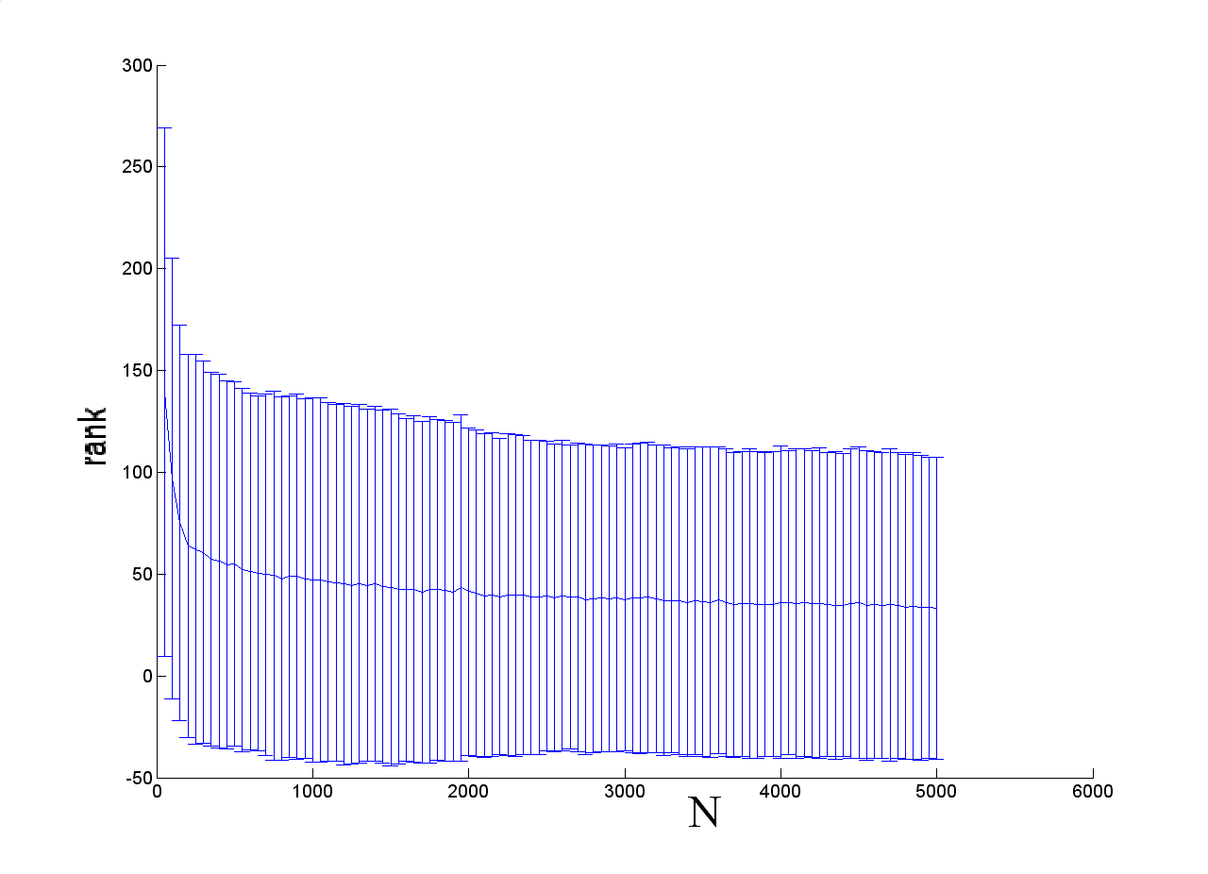
Structure Learning
Rank of the correct structure (equiv. class):

Slide 17
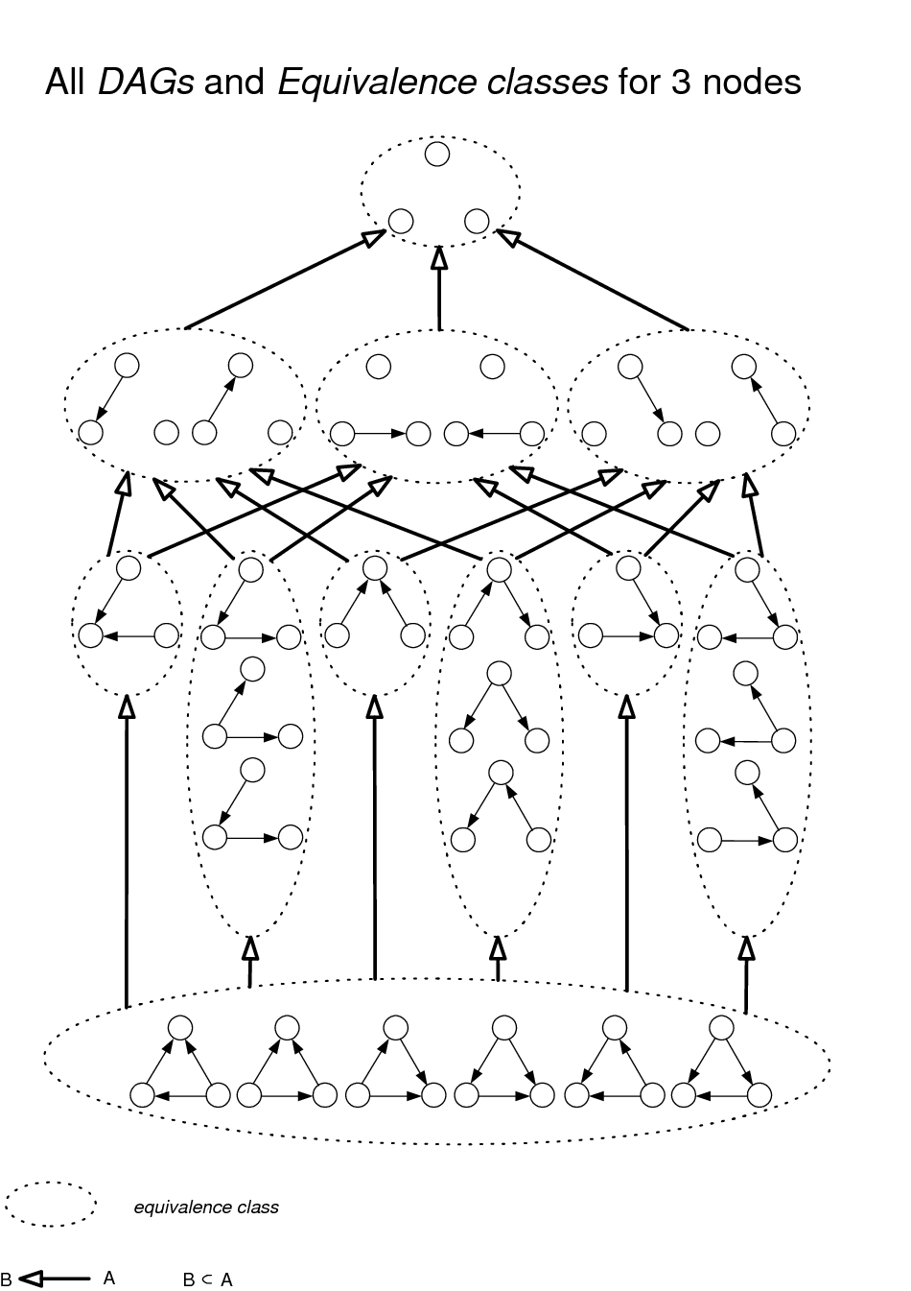
Structure Learning
All DAGs and Equivalence Classes for 3 Nodes

Slide 18
Structure Learning
An error occurs when any ‘wrong’ graph G is preferred over G*. Many possible G’s. Study them one by one.
Distinguish between two types of errors:
1. Graphs G which are not I-maps for P_{B*} (‘under-fitting’). These graphs impose to many independency relations, some of which do not hold in P_{B*}.
2. Graphs G which are I-maps for P_{B*} (‘over-fitting’),
yet they are over parameterized (|G| > |G*|).
Study each error separately.

Slide 19
Structure Learning
1. Graphs G which are not I-maps for P_{B*}
Intuitively, in order to get S_{N}(G*) > S_{N}(G), we need:
a. P^{(N)} to be closer to P_{B*} than to any point Q in G
b. The penalty difference Ψ(N) (|G| - |G*|) is small enough. (Only relevant for |G*| > |G|).
For a., use concentration bounds (Sanov).
For b., simple algebraic manipulations.

Slide 20
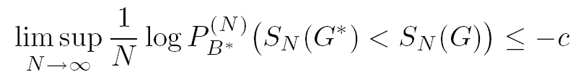
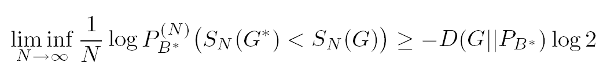
Structure Learning
1. Graphs G which are not I-maps for P_{B*}
Sanov Theorem [Sanov 57]:
Draw N sample from a probability distribution P.
Let P^{(N)} be the sample distribution. Then:
Pr( D(P^{(N)} || P) > ε) < N^{(n+1)} 2^{-εN}
Used in our case to show: (for some c>0)
For |G| ≤ |G*|, we are able to bound c:

Slide 21
Structure Learning
1. Graphs G which are not I-maps for P_{B*}
So the decay exponent satisfies: c≤D(G||P_{B*})log 2.
Could be very slow if G is close to P_{B*}
Chernoff Bounds:
Let ….
Then:
Pr( D(P^{(N)} || P) > ε) < N^{(n+1)} 2^{-εN}
Used repeatedly to bound the difference between the true and sample entropies:

Slide 22

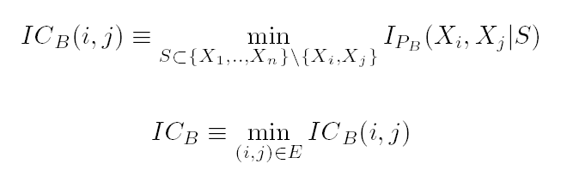
Structure Learning
1. Graphs G which are not I-maps for P_{B*}
Two important parameters of the network:
a. ‘Minimal probability’:
b. ‘Minimal edge information’:

Slide 23
Structure Learning
2. Graphs G which are over-parameterized I-maps for P_{B*}
Here errors are Moderate deviations events, as opposed to Large deviations events in the previous case.
The probability of error does not decay exponentially with N, but is O(N^{-β}).
By [Woodroofe 78], β=½(|G|-|G*|).
Therefore, for large enough values of N, error is dominated by over-fitting.

Slide 24
Structure Learning
What happens for small values of N?
Perform simulations:
Take a BN over 4 binary nodes.
Look at two wrong models
G*
X₁
G₁
X₁
G₂
X₁
X₂
X₃
X₂
X₃
X₂
X₃
X₄
X₄
X₄

Slide 25
Structure Learning
Simulations using importance sampling (30 iterations):

Slide 26
Recent Results
We’ve established a connection between the ‘distance’ (relative entropy) of a prob. Distribution and a ‘wrong’ model to the error decay rate.
Want to minimize sum of errors (‘over-fitting’+’under-fitting’). Change penalty in the MDL score to
Ψ(N) = ½log N – c log log N
Need to study this distance
Common scenario: # variables n >> 1. Maximum degree is small # parents ≤ d.
Computationally: For d=1: polynomial. For d≥2: NP-hard.
Statistically : No reason to believe a crucial difference.
Study the case d=1 using simulation.

Slide 27
Recent Results
If P* taken randomly (unifromly on the simplex), and we seek D(P*||G), then it is large. (Distance of a random point from low-dimensional sub-manifold).
In this case convergence might be fast.
But in our scenario P* itself is taken from some lower-dimensional model - very different then taking P* uniformly.
Space of models (graphs) is ‘continuous’ – changing one edge doesn’t change the equations defining the manifold by much. Thus there is a different graph G which is very ‘close’ to P*.
Distance behaves like exp(-n) (??) – very small.
Very slow decay rate.

Slide 28
Future Directions
Identify regime in which asymptotic results hold.
Tighten the bounds.
Other scoring criteria.
Hidden variables – Even more basic questions (e.g. identifiably, consistency) are unknown generally .
Requiring exact model was maybe to strict – perhaps it is likely to learn wrong models which are close to the correct one. If we require only to learn 1-ε of the edges – how does this reduce sample complexity?
        Thank You

