Slide 1
Missing heritability –
New Statistical Approaches
Or Zuk
Broad Institute of MIT and Harvard
orzuk@broadinsitute.org
www.broadinstitute.org/~orzuk

Slide 2



Genome Wide Association Studies (GWAS)
Single Nucleotide Polymorphism (SNP)
Phenotype
Genotype
length: ~3x10⁹
ACCGAGAGGGTTC/TACTATACATAGGGGGGGGGA/TGTACGGGAG/CAGGA
ACCGAGAGGGTTC/TACTATACATAGGGGGGGGGA/TGTACGGGAG/CAGGA
Height
Disease
1.68 m
Y
(0010101011101010)
[Maternal]
length: ~10⁶
(0001101100101111)
[Paternal]
1.84 m
N
(0010110010001000)
(0011110011100010)
1.74 m
N
(1101010010111110)
(0011100011101011)
1.63 m
Y
(1110101011101011)
Significant
association
(0000101011101011)
1.33 m
Y
(0010101000101010)
(1000101011100010)

Slide 3
Genome-Wide-Association-Studies (GWAS)
Variants
phenotypes
How well does it work in practice (for Humans)?
Early 2000’s: a handful of known associations
Notes:
Francis Collins famous geneticist. (Led the human genome project. Today head of NIH). Gelehrter also famous genetisist (U. Michigan)

Slide 4
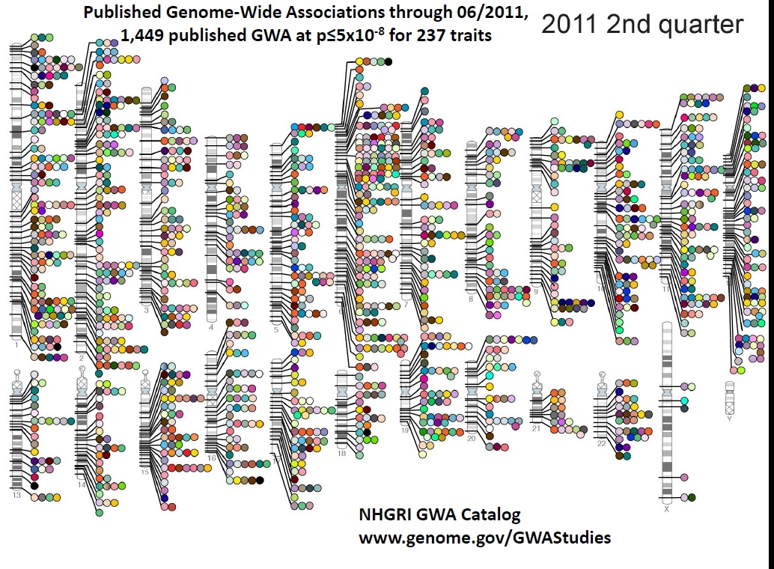
The good news:
[color - trait]
Variants
phenotypes
Type 2
Diabetes
HLA
Height
IGF
In a few years: From a handful to Thousands of
statistically significant, reproducible
associations reported genome-wide for
dozens of different traits and diseases
Notes:
Francis Collins famous genetisist. (Led the human genome project. Today head of NIH). Gelehrter also famous genetisist (U. Michigan)

Slide 5
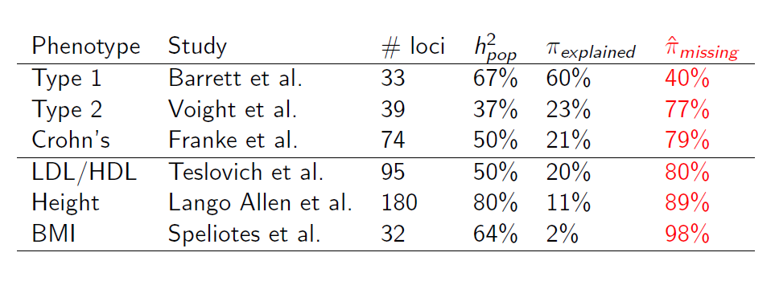
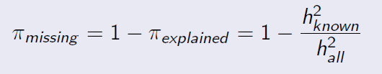

The bad news:
(Informal) Def.:
Heritability – ability of genotypes to explain/predict phenotype
Population
estimator
How much
is explained
Heritability explained
By known loci
How much
is missing
‘Total’ heritability
The variants found have low predictive power.
Most of the heritability is still missing
Notes:
Francis Collins famous genetisist. (Led the human genome project. Today head of NIH). Gelehrter also famous genetisist (U. Michigan)

Slide 6
Overview
Introduction:
  Heritability
  Missing heritability
2. The role of genetic interactions
a. Partitioning of genetic variance
b. Non-additive models create Phantom heritability
c. A consistent estimator for the heritability
The role of common and rare alleles
Wright-Fisher Model
Power correction
Analysis of rare variants

Slide 7
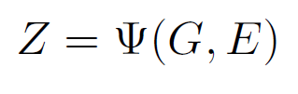
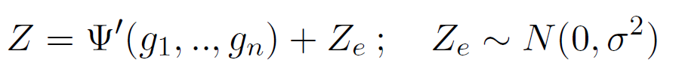


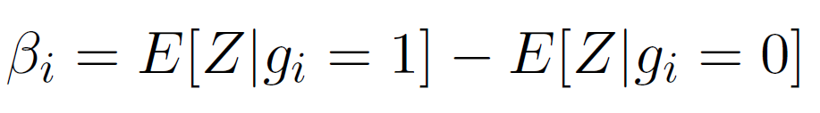
Genetic Architecture
No GenexEnvironment (GxE) Interactions:
Z – phenotype
G – genetic
E - environmental
[Normalization:
E[Z] = 0, Var[Z]=1]
We focus on: Quantitative traits
SNP (binary random variable)
Assumption:
g_{i} are in Linkage-Equilibrium
(statistically: indep. rand. rar.)
Allele frequency
Additive effect size
Notes:
G – genetic part, E – environmental part. Assuming no GxE we can partition. Epsilon typically modeled as random Gaussian noise. Heritability: Fraction of variance
Explained by genetics. We assume throughout the talk that Z is normalized.

Slide 8
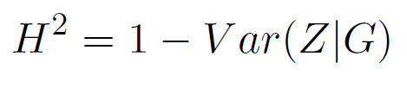
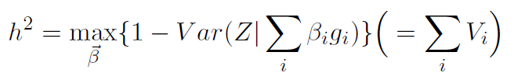
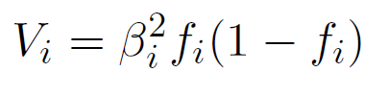
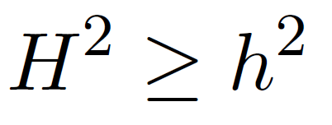
Heritability
Broad-sense:
Narrow-sense:
Individual variance is proportional to heterozygosity, and to squared effect size,
Unexplained
variance
explained
variance
explained
variance
Total
variance
Unexplained
variance
[Normalization:
E[Z] = 0, Var[Z]=1]
Additive effect size
Allele frequency
Var. expl.
By one locus
Always:
Notes:
G – genetic part, E – environmental part. Assuming no GxE we can partition. Epsilon typically modeled as random Gaussian noise. Heritability: Fraction of variance
Explained by genetics. We assume throughout the talk that Z is normalized.

Slide 9

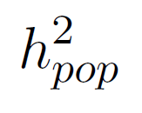
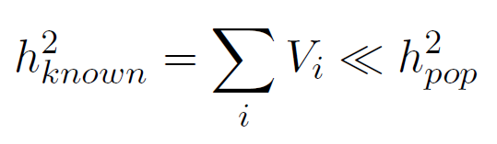



Missing Heritability
– variance explained by all known SNPs (statistically significant associations).
– heritability estimate from population data
Empirical observation:
Two explanations: (not mutually exclusive)
(i) Not all variants were found yet
(ii) Overestimation of the true heritability
(i)
(ii)
Our focus
Population estimators might be biased
Notes:
GWAS
Lets start with some theory. What is the frequency of alleles in the population?
f – frequency. s – change in # of offspring (negative) Intuition:
Alleles born, random drift + selection.
When |s| small, this is flat. When |s| large – biased towards rare alleles.

Slide 10
Overview
Introduction:
  Heritability
  Missing heritability
2. The role of genetic interactions
a. Partitioning of genetic variance
b. Non-additive models create Phantom heritability
c. A consistent estimator for the heritability
3. The role of common and rare alleles

Slide 11
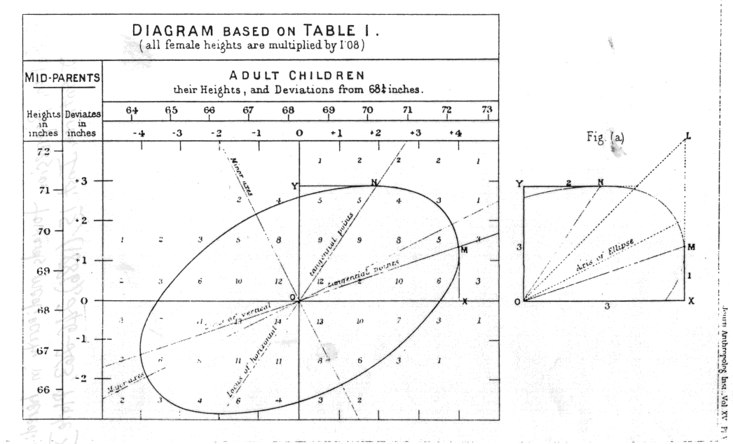
Heritability Estimates from familial correlations
‘Regression towards
mediocrity in hereditary
Stature’ [Galton, 1886]
Children’s height is correlated to mid-parents height
Correlation isn’t perfect – ‘regression towards the mean’

Slide 12


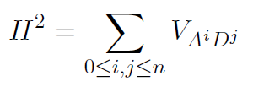




Heritability estimates from familial correlations
A – additive
D - dominance
Variance partitioning:
Environmental part
genetic part
Familial correlations:
(c_{i,j} = 2^{-(i+2j)} )
[Monozygotic twins]
[Dizygotic twins]
Model:
Additive, Common,
unique Environment.
No Interactions!
interactions
Overestimation of h² by h²_{pop}
Notes:
Hpop > hall

Slide 13
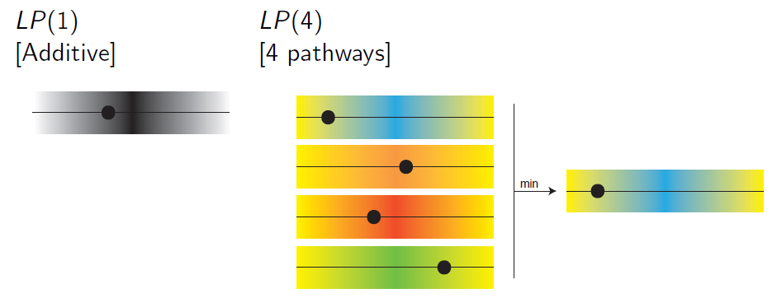

Example: The Limiting Pathway (LP) model
Simple non-additive model. Generalization of additive model
Parameterization: LP(k, h_{pathway}², c_{R})
  k – # of pathways
  h²_{pathway} – heritability of each pathway
  c_{R} – shared environment in each pathway for relative R
What is the effect on heritability estimates?
True heritability
Never explained
Estimated heritability
Notes:
Hpathway – heritability of each pathway, cr – shared environment

Slide 14
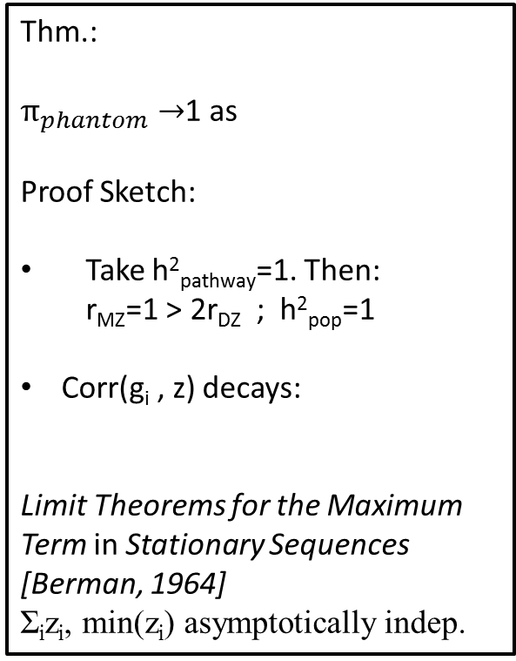


Phantom heritability for LP models
C_{r}=0%
C_{r}=50%
[Each point: LP(k, h_{pathway}², c_{R})]
Thm.:
$π_{phantom}→$1 as
Proof Sketch:
Take h²_{pathway}=1. Then:
r_{MZ}=1 > 2r_{DZ} ; h²_{pop}=1
Corr(g_{i} , z) decays:
Limit Theorems for the Maximum Term in Stationary Sequences [Berman, 1964]
Σ_{i}z_{i}, min(z_{i}) asymptotically indep.
K=10
$$k→∞$$
K=7
K=6
K=5
Overestimation
K=4
K=3
K=2
K=1
$$h_{all}^{2}→0$$
Heritability estimate from twins
h²_{pop} not very sensitive to k.
Overestimation increases with k
Real observational data is consistent with non-additive models
Holds for both quantitative and disease traits

Slide 15
Twin Correlations for LP models:
[Data: P. Visscher et. al.
PLoS Gen. 2006]
[Same LP models]
Real observational data is consistent with non-additive models
Holds for both quantitative and disease traits

Slide 16

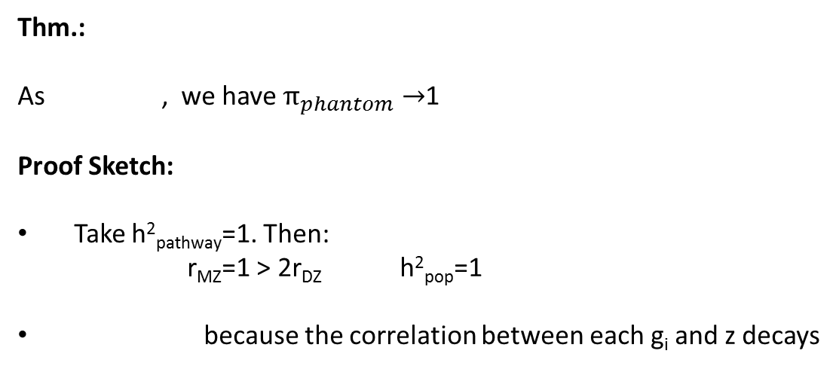

Phantom heritability can be close to one
Thm.:
As , we have $π_{phantom}→$1
Proof Sketch:
Take h²_{pathway}=1. Then:
r_{MZ}=1 > 2r_{DZ} h²_{pop}=1
because the correlation between each g_{i} and z decays
$$k→∞$$
$$h_{all}^{2}→0$$
Limit Theorems for the Maximum Term in Stationary Sequences [Berman, 1964]
Σ_{i} z_{i}, and min(z_{i}) are asymptotically independent

Slide 17
Power to Detect Interactions from Genetic Data
Pairwise Test
Test: χ² on 2x2x2 table (SNP₁, SNP₂, disease-status)
Expected: best-fit additive model
Test statistic: Non Central χ² distribution.
t ~ χ²(NCP, 1); P-val = (χ²)⁻¹(t, α)
NCP ~ (effect-size)x(sample-size)
Marginal effect-size : ~β_{i} (additive effect size)
Interaction effect-size : deviation from additivity of two loci
Main effects - O(1/n) ; Pairwise interactions - O(1/n²)
Pathway Test
Test for meta-interaction between two sets of SNPs to increase power
Can incorporate prior biological knowledge (pathways)
SNP₁ \ SNP₂ | 0 | 1
0 | 0 | 0
1 | 0 | 1
Low power to detect interactions in current studies

Slide 18
Marginal effect
Pairwise epistasis
Pathway epistasis
Greedy
Algorithm
(inclusion
of SNPs in
pathways)
Sample size
Here Plot detection power
Variance explained by single locus
[Model: LP(3, 80%). 20 SNPs in each pathway.]
Power to detect marginal effect: high
Power to detect pairwise interaction effect: low
Improved tests incorporating biological knowledge: useful, but challenging

Slide 19

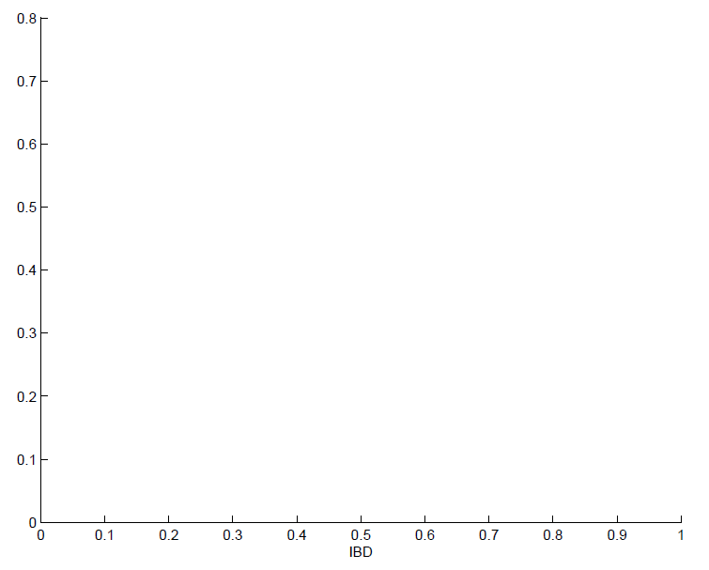
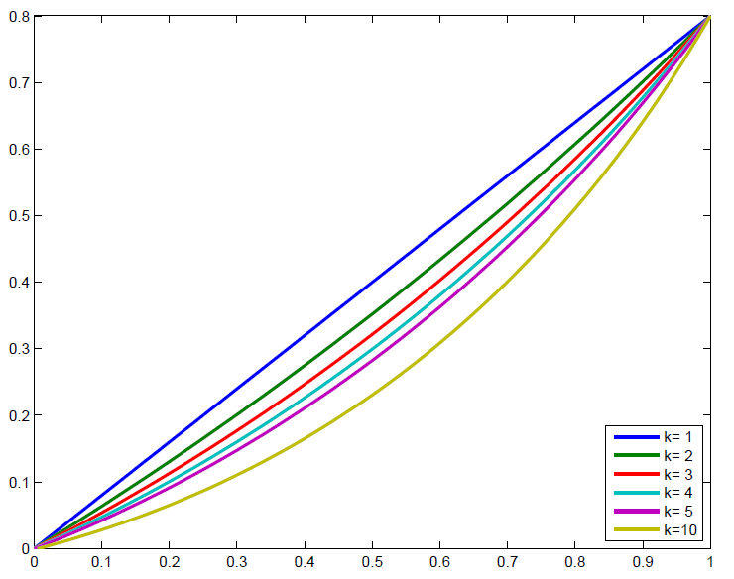

A consistent estimator for Heritability
Correlation as function of IBD sharing for LP(k,50%) model
Heritability: Change in phenotype similarity
Change in genotypic similarity
Phenotypic
correlation
Traditional
estimates
grand-parents
grand-children
DZ-twins, sibs,
parent-offspring
alternative
estimate
MZ-twins
first-cousins
Fraction of genome shared by descent
Answer may depend on location of slope estimation

Slide 20
A consistent estimator for Heritability
Use variation in Identity-by-descent (IBD) sharing
Intuition: larger IBD -> more similar phenotype
Model:
Ancestral population:
Current population:
G₁
G₂
……….
IBD – fraction coming from same ancestor (same color)

Slide 21
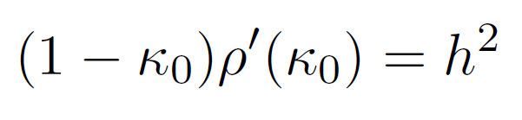
A consistent estimator for Heritability
κ₀ – average fraction of the genome shared (in large blocks)
between two Individuals.
ρ(κ₀) – correlation in trait’s phenotype for pairs of individuals
with IBD sharing level κ_{0.}
Thm.:
Proof idea: (i) Interactions vanish for unrelated individuals.
(ii) Z, Z_{R} are conditionally independent at κ_{0.}
Advantages:
1. Not confounded by genetic interactions and shared environment
2. No ascertainment biases (recruiting twins ..) –
can attain larger sample sizes
3. Can be measured on the same population in
which SNPs are discovered

Slide 22
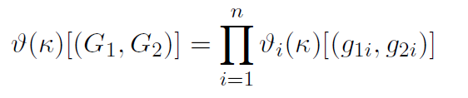
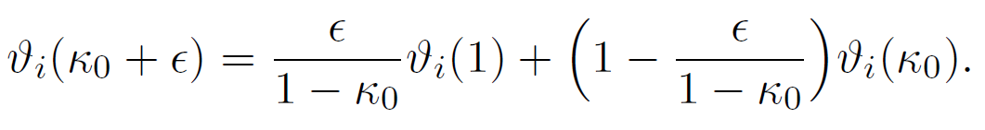
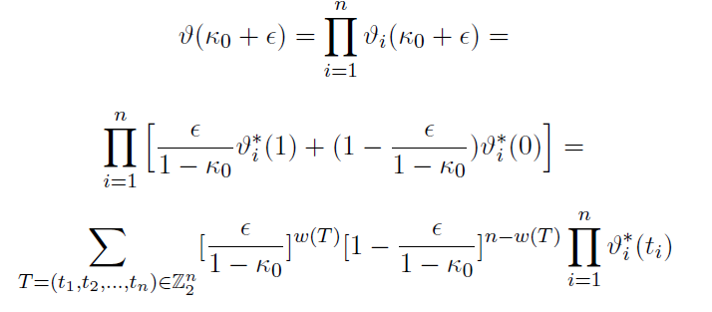
A consistent estimator for Heritability: Proof
1. Genotypic correlation:
Product distribution
Joint genotypic
distribution
Full dependence
Full
independence
Sum over
All 2^{n} binary
vectors
Hamming
weight

Slide 23
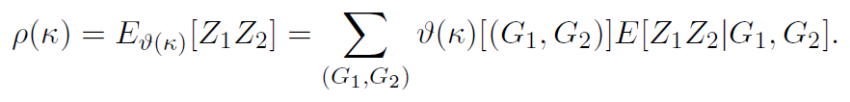
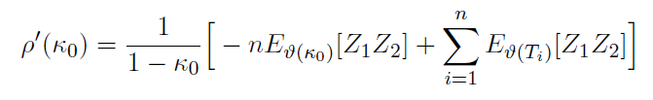
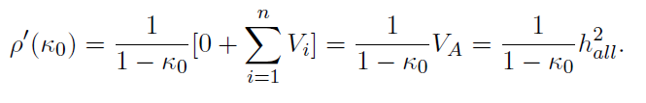
A consistent estimator for Heritability: Proof
2. Phenotypic correlation :
Condition on IBD sharing
Condition on genotypes
Sum over n+1 terms
Substitute
Genotypic correlation
In derivative formula
(ε² terms vanish)
Conditional
independence

Slide 24
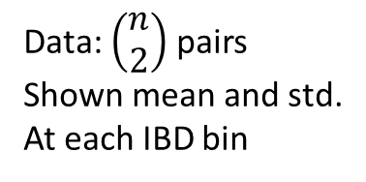
Simulation results
Model:
LP(4, 50%)
h² = 0.256
h²_{pop} = 0.54
Data: $\left(\begin{matrix}n \\ 2\end{matrix}\right)$ pairs
Shown mean and std.
At each IBD bin
Algorithm for
weighted regression
(correlation structure
for all pairs)
κ₀
(n=1000, averaged 1000 iteration)
Unbiased estimator for a finite sample

Slide 25
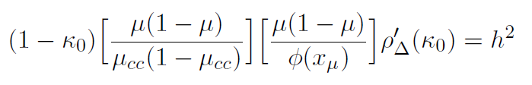
A consistent estimator for Heritability (disease case)
κ₀ – fraction of the genome shared (in large blocks) between two
Individuals.
ρ∆(κ₀) – correlation for pairs of individuals With IBD sharing level κ_{0.}
µ - prevalence in population;
µ_{cc} – fraction of cases in study
Thm.:
Proof: (1.) liability-threshold transformation
(2.) Adjustment for case-control sampling [Lee et. al. 2011]
ascertainment
bias correction
transformation
to liability scale
heritability
measured on
liability scale
[Zuk et. al., PNAS 2012]
A consistent estimator for disease case

Slide 26
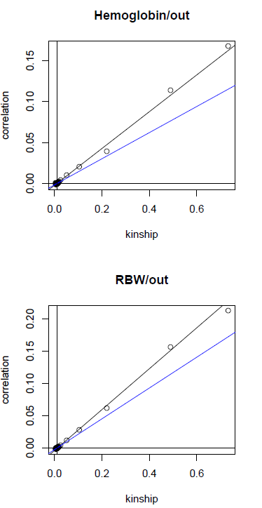
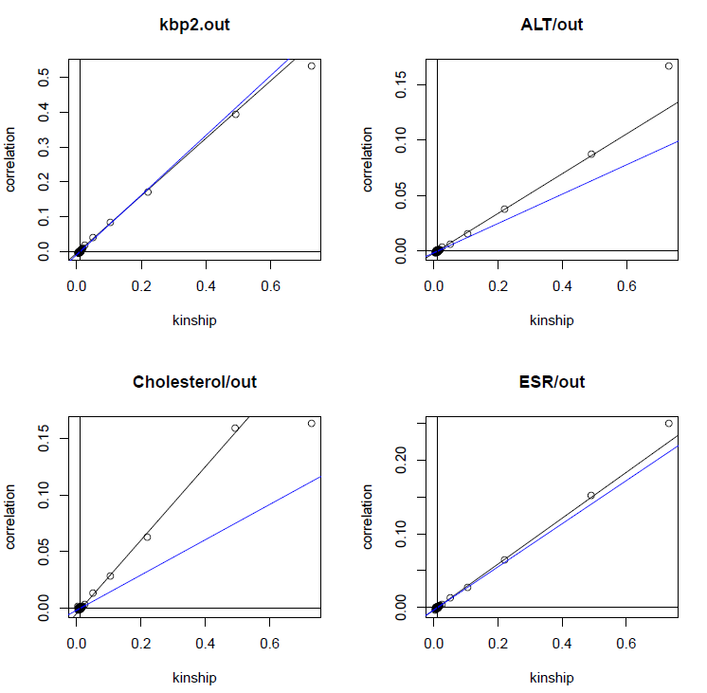
Real Data (prelim. Results)
Icelandic population, various traits. ~10,000 individual (numbers vary slightly by trait)
12/15 traits: significant over-estimation (by permutation testing)
Blue – distant
relatives (κ<0.01)
Black – close
relatives (κ>0.01)
A Significant gap (up to x2) for some traits

Slide 27
Conclusions (this part)
Genetic Interactions confound heritability estimates
Current arguments in support of additivity are flawed
A new, consistent, practical heritability estimator
Can estimate the minimum possible error of a linear model
Extensions: Higher derivatives give additional
components of the variance
6. Application to real data:
Isolated populations (Korsea, Iceland, Finland, Qatar)
(larger IBD blocks -> more stable estimators)

Slide 28
Overview
Introduction:
  Heritability
  Missing heritability
2. The role of genetic interactions
a. Partitioning of genetic variance
b. Non-additive models create Phantom heritability
c. A consistent estimator for the heritability
3. The role of common and rare alleles

Slide 29
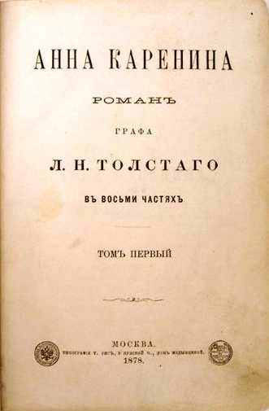

Two Models
``Happy families are all alike;
every unhappy family is unhappy in its own way.”
``All happy families are more or less dissimilar;
all unhappy ones are more or less alike”
Rare variants are dominant
[M.-Claire King, D. Botstein]
Common-Disease-Common-Variant
Hypothesis (CDCV, Reich&Lander, 2001)

Slide 30
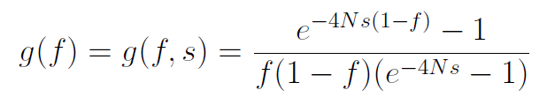

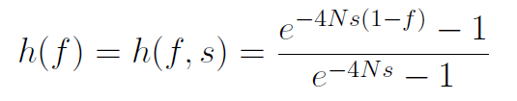
Population Genetics Theory
Generalized Fisher-Wright Model [Kimura&Crow 1968]
(constant population size, random mating)
f – allele frequency, s – selection coefficient, N – population size
(mean # offspring for mutation carrier: 1+s)
Model: discrete-time discrete-state random process.
N large -> continuous time continuous space diffusion approximation
[s≤0. deleterious]
Number of generations spent at frequency f:
Contribution to variance explained h at frequency f:
Notes:
GWAS
Lets start with some theory. What is the frequency of alleles in the population?
f – frequency. s – change in # of offspring (negative) Intuition:
Alleles born, random drift + selection.
When |s| small, this is flat. When |s| large – biased towards rare alleles.

Slide 31
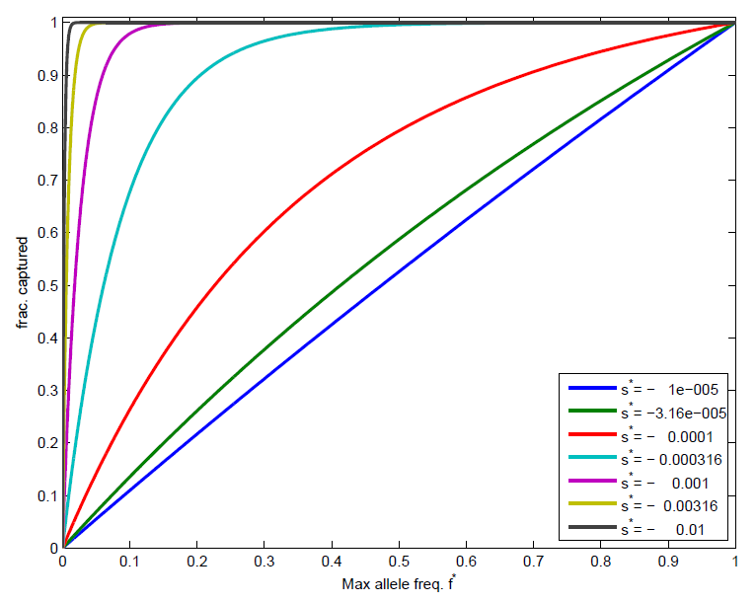
Variance Explained Cumulative Distribution
Effective
population
size:
N=10,000
Notes:
MAF – minor allele frequency. Shown is distribution of variance explained for different values of s. Quantiles.
N = 10,000. Effective population size for humans
For disease: s = alpha*beta*gamma (prevalence, allele freq., reduction). Too small

Slide 32
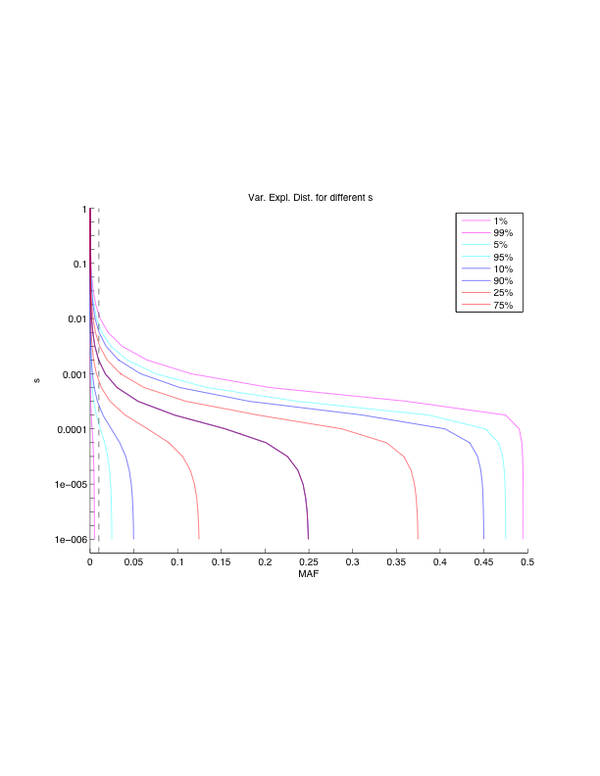
Variance Explained Quantiles
selection
|
Effective
population
size:
N=10,000
Allele frequency
Notes:
MAF – minor allele frequency. Shown is distribution of variance explained for different values of s. Quantiles.
N = 10,000. Effective population size for humans
For disease: s = alpha*beta*gamma (prevalence, allele freq., reduction). Too small

Slide 33
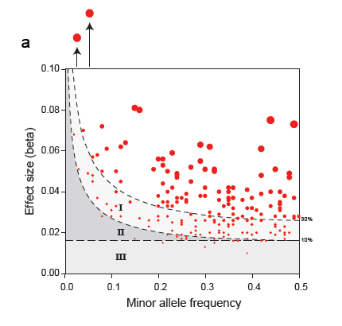
Example: GWAS data on Height
180 loci
[Lango-Allen et al., Nature 2010]
Area proportional to
variance explained
Notes:
Power. I – high power. II – low power. III – low power.

Slide 34
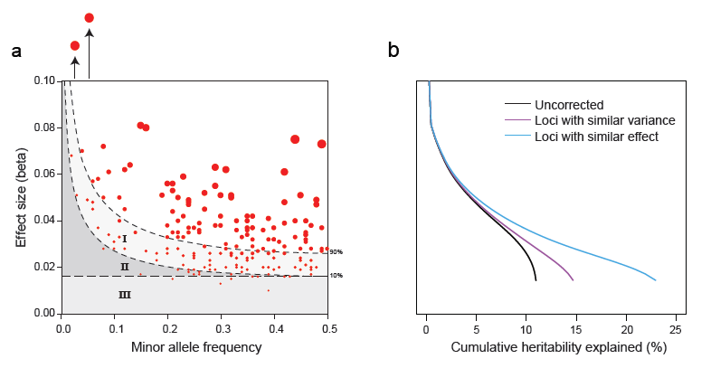

Correcting for lack of power
I. Loci with Equal Variance (LEV)
#Loci ~ # found-loci/power [Lee et al., Nat. Gen. 2010]
II. Loci with Equal Effect Size (LEE)
III. Loci with Tiny Effect Size (LTE) Random Effects Model
[Yang et al. Nat. Gen. 2010]
Notes:
Power. I – high power. II – low power. III – low power.

Slide 35
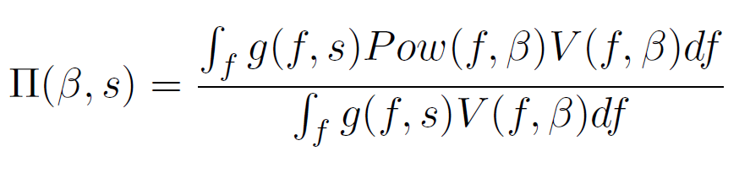
II. Loci with Equal Effect Size (LEE)
1. Fraction of variance explained for discovered loci,
Density of
alleles
Power to
detect
Variane
explained
Allele frequency
Notes:
Power. I – high power. II – low power. III – low power.
Model: allele-frequency generator. Power – censores.

Slide 36
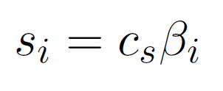

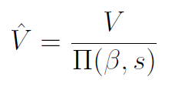
II. Loci with Equal Effect Size (LEE)
1. Fraction of variance explained for discovered loci,
2. Model: selection proportional to effect size
3. Fit c_{s} using maximum likelihood:
4. Variance explained estimator:
Advantages: 1. Gives correction in additional region
2. Can infer allele-frequency distribution
(in all cases, fitted s<10⁻³)
selection
coefficient
effect size
observed
var. explained
inferred
var. explained
correction
factor
Shown correction for summary statistics (top-SNPs).
Similar correction for raw SNP data (use P. Visscher’s random effects model)
Notes:
Power. I – high power. II – low power. III – low power.
Model: allele-frequency generator. Power – censores.

Slide 37
Results
Quantitative Traits
Trait | # loci | h²_{pop} | h²_{known} | LEV | LEE | LTE
BMI | 32 | 64% | 2.2% | 2.9% | 4.5% | XXX
Height | 180 | 80% | 11.1% | 15.4% | 24.2% | 56% [Yang et al.]
HDL | 95 | 50% | 22% | 32.2% | 33.0% | XXX
LDL | 95 | 50% | 20% | 33.2% | 35.5% | XXX
Menarche (age of onset) | 42 | 49% | 4.34% | 6.37% | 11.95% | XXX
Triglyceride | 95 | 46% | 17% | 40.6% | 45% | XXX
Disease Traits
Disease | # loci | Prevalence | h²_{pop} | h²_{known} | LEV | LEE | LTE
Breast Cancer | 18 | 5% | 37% | 7.7% | 20.4% | 40.6% | XXX
Crohn’s Disease | 74 | 0.20% | 57% | 21.4% | 32.3% | 40.2% | 42% [Lee et. al.]
Type 1 Diabetes | 33 | 0.40% | 67% | ~60% | 68% | 74.4% | 48% [Lee et. al] (excludes MHC)
Type 2 Diabetes | 39 | 8% | 37% | 23% | 31.9% | 35.2% | XXX

Slide 38
Rare Variants Studies
Heritability explained computed in the same way.
But: data available is different.
[Cumulative frequencies of all rare-alleles, sequences extremes of the population, prediction of functional rare variants ..)
Analyzed on a case-by-case basis:
Quantitative Traits
Disease Traits
Trait | #Genes in Analysis | β | f | Variance expl.
HDL | 3 (ABCA1, APOA1, LCAT) | -0.51 | 0.07 | 3%
BMI | 21 | 0.164 | 0.09 | 0.44%
Blood pressure | 3 (SLC12A3/1, KCNJ1) | -0.76 | 0.015 | 1.70%
Tri-glycerides | 3 (ANGPTL3/4/5) | -0.59 | 0.02 | 1.50%
HTG | 4 (APOA, GCKR, LPL, APOB) | 0.427 | 0.09 | 2.90%
Trait | #Genes in Analysis | OR | f | Variance expl.
Crohn's | 1 (4 variants in IL23R) | 2.4 | 0.01 | 0.44%
Type 1 diabetes | 1 (4 variants in IFIH1) |  | 0.01 | 0.70%
Use population genetics model for:
Estimating variance explained
Improved test for rare-variants association
Contribution of rare alleles so far is minor
[Zuk et. al., in prep.]

Slide 39
Conclusions
Theory doesn’t support a major role for rare variants for most traits
Current data is inconclusive
New framework for analyzing rare variants studies
Improved tests for rare variants discovery
[Zuk et al., in prep.]

Slide 40



Thanks
Eliana Hechter
Shamil Sunyaev
Eric Lander

