Slide 1
Detection of Rare-Alleles and Their Carriers Using Compressed Se(que)nsing
Or Zuk
Broad Institute of MIT and Harvard
orzuk@broadinstitute.org
In collaboration with:
Amnon Amir
Dept. of Physics of Complex Systems, Weizmann Inst. of Science
Noam Shental
Dept. of Computer Science, The Open University of Israel
Notes:
Hello, my name is Or Zuk from the Broad Inst. I thank the organizers for the opportunity to speak here.
This is joint work with Amnon Amir and Noam Shental, both from Israel.

Slide 2






The Problem
Identify genotypes (disease) in a large population
AB
AA
AA
AA
AA
AB
AA
AA
AA
genotypes
Specifics:
Large populations (hundreds to tens of thousands)
Rare alleles
Pre-defined genomic regions

Slide 3
Naïve Approach – Targeted selection + Next Gen Seq.: One Test per Individual
collect DNA samples
Targeted
selection
Apply 9 independent tests
AB
AA
AA
AA
AA
AB
AA
AA
AA
1/2
0
0
0
0
1/2
0
0
0
fraction of B’s out of tested alleles
Problem: Rare alleles require profiling a high number of individuals.
Still very costly.
Multiplexing/barcoding provides partial solution (laborious, expensive,
often not enough different barcodes)
Notes:
The naïve approach:
Extract DNA from each individual,
Enrich for specific regions of interest (PCR / hybrid selection)
Sequence each indiviudal in an individual run/lane (can allow multiplexing via barcodes)

Slide 4
Our approach - Targeted Selection +
Smart pooling + Next Gen seq.
collect DNA samples.
Prepare Pools
Targeted
selection
Apply 3 pooled tests
Reconstruct genotypes
AB
AA
AA
AA
AA
AB
AA
AA
AA
1/2
0
0
0
0
1/2
0
0
0
fraction of B’s out of tested alleles
Advantages: Fewer pools
Reduced sample preparation and sequencing costs
Can still achieve accurate genotypes

Slide 5
Application 1:
Rare recessive genetic diseases
Genotype
Phenotype
Normal
Healthy
Carrier
Healthy!
Affected
Sick
Identify carriers of known deleterious mutations
Notes:
Good allele: Wild-type allele
Bad allele: deleterious allele / disease causing allele

Slide 6
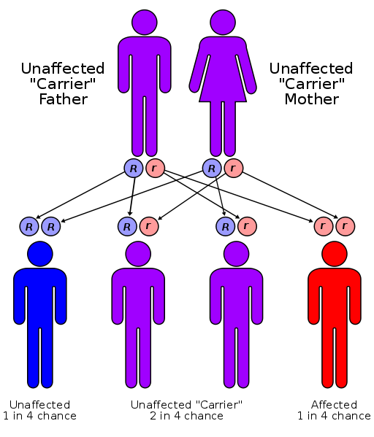
Nationwide carrier screen
Notes:
Genetic couseling
Replace R r by A B
/ affected Carries the disease
We want to perform prenatal/carrier scan for disease associated alleles

Slide 7

Large scale carrier screen
Genetic Disorder | Carrier rate
Tay-Sachs | 1:25
Cystic Fibrosis | 1:30
Familial Dysautonomia | 1:30
Usher Syndrome | 1:40
Canavan | 1:40
Glycogen Storage | 1:71
Fanconi Anemia C | 1:80
Niemann-Pick | 1:80
Mucolipidosis type 4 | 1:100
Bloom | 1:102
Nemaline Myopathay | 1:108
(rates vary across ethnic groups)

Slide 8
Specific mutations - notation
Reference genome
…AGCGTTCT…
“A”
Single-nucleotide polymorphism (SNPs)
…AGTGTTCT…
“B”
Insertions/Deletions (InDels)
…AGGTTCT
“B”
Carrier test screen: Amplify a sample of DNA and then test
“AA”
“AB”
0
1/2
fraction of B’s out of tested alleles
Notes:
How does a specific mutation look like?
It can be a SingleNucleotidePolymorphism, or insertion deletion. A denotes the reference allele and B denotes the mutant, disease causing allele. For the sake of simplicity we will talk about SNPs from now on

Slide 9
Application 2:
Genome Wide Association Studies
Cases
Controls
collect DNA samples
AA
AA
AA
AA
AA
AB
AA
AB
AA
AB
BB
AB
BB
AA
AB
AB
AA
AB
Count:
 | Cases | Controls
AA | X_{AA} | Y_{AA}
AB | X_{AB} | Y_{AB}
BB | X_{BB} | Y_{BB}
Statistical test,
p-value
Try ~10⁵ – 10⁶ different SNPs. Significant ones called ‘discoveries’/’associations’

Slide 10
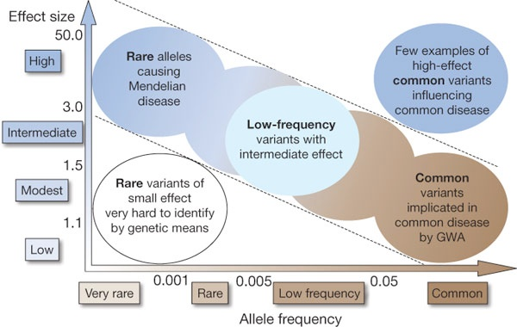
What Associations are Detected?
Goal: push further
Find Novel mutations associated with common disease and their carriers
[T.A. Manolio et al. Nature 2009]
Notes:
GWAS are successful in recent years – many associations are found.
Effect size: how different is the frequency between cases and controls/ how strong is the association between marker and disease.
Frequency: how rare in the population.
The more rare, and the lower the effect – harder to find. Most ‘low-hanging fruits’ have been found. So far, using arrays.
Now progress requires profiling larger populations to find SNPs with lower MAF.

Slide 11
What Associations are Detected?
Find Novel mutations associated with common disease and their carriers
Proposed approaches:
Profile larger populations.
Look at SNPs with lower Minor Allele Frequency
Re-sequencing in regions with common SNPs found, and other regions of interest
Notes:
So we need to profile larger populations.
Important : some of the SNPs/deletions are not in SNPs data bases since they are rare /specific to populations
Need to perform sequencing!

Slide 12
Compressed Sensing Based Group Testing
Next Generation Sequencing Technology
fraction of B’s
infer/reconstruct
compressed sensing (CS)
a few tests instead of 9
Notes:
Do the animation according to the speach

Slide 13
Rare Allele Identification in a CS Framework
# rare alleles
individuals in the pool
Notes:
We map the problem to CS.
X is the vector of unkown genotypes: 0 means reference homozygous (AA), 1 means heterozygous (AB) and 2 means rare homozgous (BB)
X_i simply counts the number of B alleles.
M_i is the measurement or pooling vector: 1 for each person participating in the pool (normalized)

Slide 14
Compressed Sensing (CS)
The standard CS problem:
n variables
k << n equations
But: x is sparse:
Matrix should obey certain properties (Robust Isometry Property)
    Example: random Gaussian or Bernoulli matrix
Then: Can reconstruct x uniquely with k = O(s log(n/s)) equations (a.k.a. ‘measurements’)
Can do so efficiently, even for large matrices (L₁ minimization)
Notes:
Here I’ll describe briefly what is compressed sensing in a nutshell.
So you have a very simple problem: linear system y = Mx.
But the problem is that you have fewer equations than unknowns, k << n.
In general, as we all know, there is no unique solution. But, here we have an additional information that X is sparse: most entries are zero!
(in our case, most individuals don’t carry the mutation). That’s why it’s called compressed sensing: X is sparse hence compressible (not interested in general X) . Sensing is compressed since we only perform a few measurements (instead of n measurements and then compressing X)
Then, it turns out: 1. there is a unique solution. 2. there are efficient algorithms that can find it

Slide 15
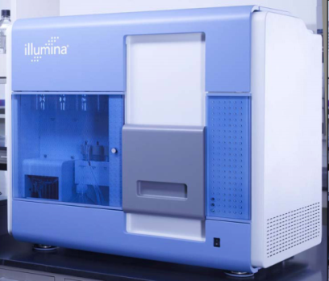
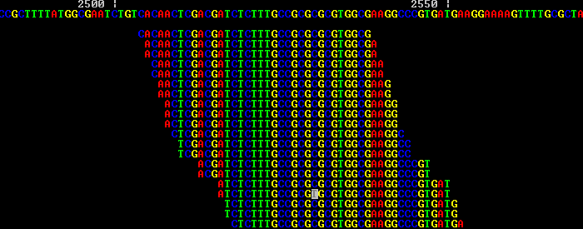
NextGenSeq Output
output: “reads”
Example: Illumina, A few millions reads per lane
Read length – a few dozens to a few hundreds
line = “read”
Notes:
So we want to measure the freq. of B in each pool. How does it work in practice?
Next gen sequencing. Several technologies:
We used illumina – parameters
We look at one pool:
Output of the machine: Short reads of length a few tens of nucleotides
Reads are aligned to the genome
L
Regular – sequence a genome: create a refernce
Finally, DNA of each pool is sequenced in a separate lane, and reads are
mapped back to the reference genome (this may be performed using standard alignment
algorithms such as MAQ [35].)

Slide 16
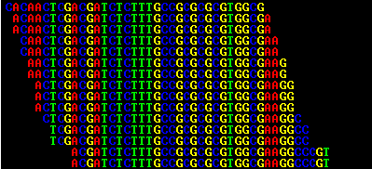
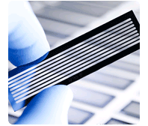
NextGenSeq – Targeted Sequencing
Measure the number of reads containing B out of total number of reads. Here: 1/16
Notes:
Then you look at a specific locus
simply count number of reads
How I compute measurement: ratio for each pool ..
# rare allele / total # reads

Slide 17
Model Formulation
Ideal measurement - the fraction of “B” reads:
NGST measurement:
1. sampling noise: finite number of reads from each site - r
, Estimated frequency:
r is itself a random variable
2. Technical errors:
read errors: 0.5-1%
DNA preparation errors
sparsity-promoting
term
error term
Parts of this modeling appeared in [P. Prabhu & I. Pe’er, Genome Research July 09]
Notes:
We model the sequencing process using a probabilistic model:
Limited amount of reads: sampling error: a binomial distribution r is the coverage, y_i the true frequency
Variations in coverage between regions: r is taken from some (gamma distribution)
Our model contain technical errors: read error (can output read different than actual genotype) and variation in amount of DNA in different individuals (guassian error in DNA quantities in the pool)

Slide 18
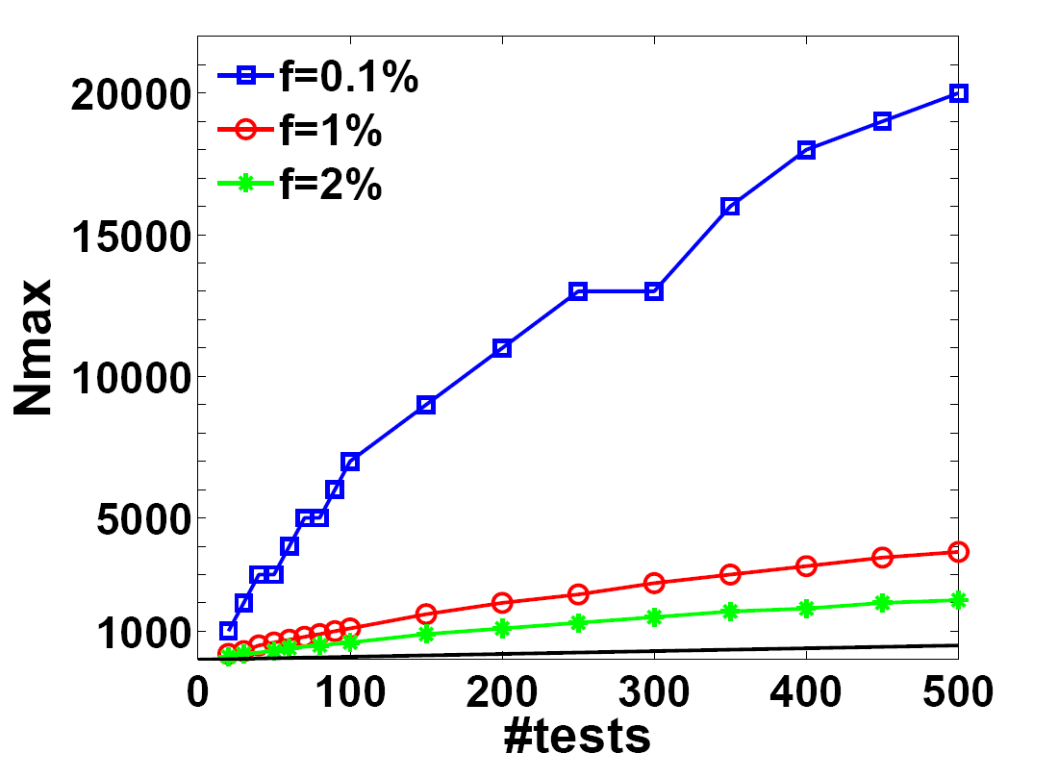
Results (simulations)
[f = freq. of
rare allele]
Can reconstruct over 10,000 people with no errors, using only 200 lanes
Software Package: Comseq
[unique solver for this application noise model, translating to CS, reconstruction ..]
arxiv 0909.0400v1
Notes:
Lets see how well do we perform:
For each number of lanes – what is the maximal number of individuals for which we recunstruct their genotypes with no error AT ALL

Slide 19
Results (real data)
  Pooled-sequencing experimental data
  Validate the Pooling part (variation in amount of DNA)
  2. 1000 genomes data
  Validate all other technical errors (e.g. read error, sampling error ) in a large-scale experiment
Notes:
Unfortunately, no data is available for applying whole approach
We’re gonna use two datasets that validate different aspects of our model.
First : a real pooling experiments – validates the pooling error and assumption about linearity of carrier frequencies in the pool.
The second: ground truth on a large sclae experiment (hundreds of indviduals) large statistics (many SNPS) …

Slide 20
Results (dataset 1)
  Pooling dataset from: [Out et al., Human Mutation 2009]
  88 People in one pool – region length (hyb-selection)
  sequenced by
  5 SNPs identified, of which 9 are ‘rare’ (carrier freq. < 4%):
  5 with one carrier, 3 with two carriers, 1 with one carrier.
  Create ‘in-silico’ pools:
  Randomize individuals’ identity in each pool
  Determine number of carriers
  Sample frequencies based on observed frequencies in the single pool for the same number of carriers

Slide 21
Results (dataset 1)
  Pooling dataset from: [Out et al., Human Mutation 2009]
  Cartoon:

Slide 22
Results (dataset 1)
% with perfect reconstruction
# tests
One and two carriers: real pooling results match theoretical model
Three carriers: real pooling are worse due to one problematic SNP
When constructing pools of at most 2 people, results match theoretical model

Slide 23
Results (dataset 2)
  1000 Genomes Data: http://www.1000genomes.org/
  Pilot 3 data: Exome Sequencing, ~1000 genes, ~700 people
  Filtered: 633 rare SNP (MAF < 2%), of which 20 contained rar heterozygous
  364 individuals sequenced by Illumina
  Create ‘in-silico’ pools:
  Randomize individuals’ identity in each pool
  Determine number of carriers
  Sample and individual from the pool at random. Then sample a read
  from the set of reads for this individual.
Notes:
We used the 1000 genomes pilot 3 dataset,
and took 364 individuals sequenced on the same platform.
were 633 rare SNPs identified …

Slide 24
Results (dataset 2)
Results from derived from actual 1000 genomes read match
Simulations from our statistical model

Slide 25
Conclusions
Generic approach: puts together sequencing and CS to identify rare allele carriers.
Naturally deals with all possible scenarios of multiple carriers and heterozygous or homozygous rare alleles.
Much higher efficiency over the naive approach. Can be combined with barcoding
Manuscript available on arxiv:
    arxiv 0909.0400v1 [N. Shental, A. Amir and O. Zuk, in revision]
Comseq Package: Code Available at:
    http://www.broadinstitute.org/mpg/comseq
[simulating, designing experiments, reconstructing genotypes ..]

Slide 26
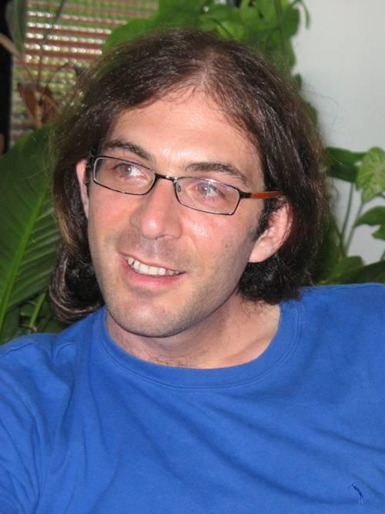
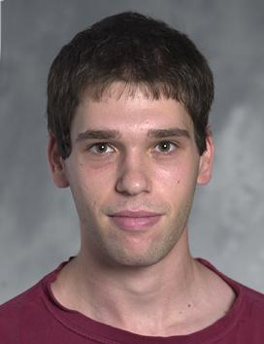
Noam Shental Amnon Amir
Thank You
Notes:
These are the guys who did most of the work – I’m standing here for purely geographic reasons
Thank you for your attention and I’ll be happy to take questions

